Slide 1


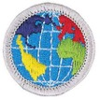

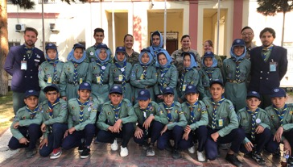
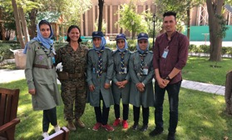
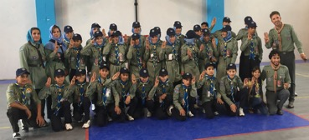
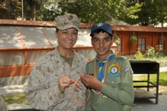
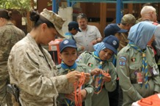
You may earn the International Spirit Award by doing the following:
1) Earn the Boy Scout World Conservation Award.
2) Earn the Citizenship in the World Merit Badge.
3) Participate in Jamboree-on-the-Air or Jamboree-on-the-Internet.
4) Organize a World Friendship Fund collection at a unit meeting or district roundtable.
5) Complete three of the 10 Experience Requirements.
You may earn the World Conservation Award by earning the following merit badges:
1. Environmental Science OR Sustainability merit badge
2. Soil and Water Conservation OR Fish and Wildlife Management merit badge
3. Citizenship in the World merit badge
4. AND participate in a conservation project as part of an approved Scouting program totaling at least three hours that addresses a conservation need common to more than one country.
https://www.afghan-scouts.org

Slide 2
The Mission of Scouting is to contribute to the education of young people, through a value system based of the Scout Promise and Law,
To help build a better world where people are self fulfilled as individuals and play a constructive role in society.
Role of national scouting organization support scouting in respective countries
Key initiatives:
  World Scout Environment Programme
  Messengers of Peace
  Scouts of the World Award
  Scouts Centres of Excellence for Nature and Environment (SCENES)

Slide 3
Agenda
Complete three of the 10 Experience Requirements – We will complete two of the requirements
#7. Research Scouting in another country. Make a presentation at a unit meeting or district roundtable.
#10. Research a region of the World Organization of the Scout Movement. Make a presentation at a unit meeting or district roundtable.

Slide 4
Scouting is a global movement with over 54 million Scout world wide
171 member organizations; with Afghanistan being the most recent, in 52 countries
Scouts BSA became a founding member in 1922
  Largest scouting organization and one of the largest youth organizations in the US – 2.3 million youth participants and about one million adult volunteers

Slide 5

Scout Regions
Eurasia Region
Interamerican Region
European Region
Asia Pacific
Arab Region
African Region

Slide 6
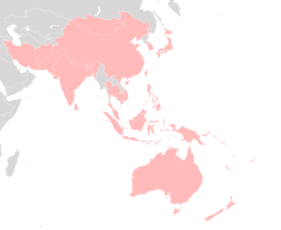

Asia Pacific - Afghanistan
Headquarters in Makati City, Philippines
Founded in 1956
Grew from 27 member countries by 2016 and has over 30 million scouts
Eight of 15 largest Scouting associations in the world are in this region
All of the former Communist States in Central Asia and Soviet Union have developed scouting programs
** Afghanistan rejoins the scout movement on January 7, 2020 to become the 171 country

Slide 7


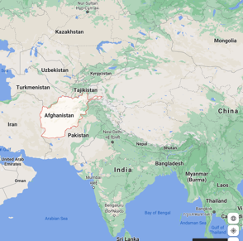
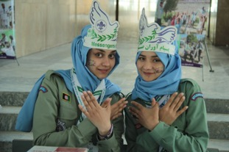
Asia Pacific - Afghanistan
Afghan Leaders worked over a decade to get admitted into the WOSM
Afghanistan scouting goes back to 1931. Lost membership due to conflicts in 1979.
In 2010, PARSA accepted the challenge of supporting the development of a national Afghan Scouts program
Started with two Scout troops in a local orphanage and $1500. Today, with 11,000 youth participating and in strong partnership with the Ministry of Education, the Afghan Scouts has been acknowledged nationally and internationally as an impactful volunteer-led youth movement.
Many of the youth who participate in PARSA’s Afghan Scouts program are orphans or come from impoverished backgrounds. PARSA supports program costs including uniforms, training activities, and community service through grassroots fundraising and grants.
The mission of the Afghan Scout Movement is to contribute to the education and development of young people through a value system based on the Scout Promise and Law; to encourage the growth of self-esteem and fulfillment in individual Scouts; and to play a constructive role in the future of Afghanistan by developing strong leadership skills in Afghan youth.

Slide 8
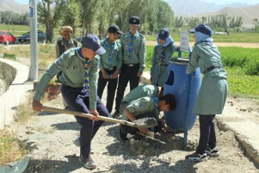
Asia Pacific - Afghanistan
Scouting Activities
Like Scout troops around the world, PARSA’s Afghan Scouts take part in regular troop meetings, earn badges, and serve their communities. Community service is an essential part of the program because it demonstrates the value of youth to each community and helps troops gain acceptance. Volunteer Scout Masters take part in regular trainings at the PARSA Afghan Scout Training Centre in Kabul, and earn their Wood Badge certifications with oversight from WOSM.
Merit Badges
Citizenship
Cooking
Drug Awareness
First Aid
Safety
Sanitation Promoter
Agriculture
Camping
Environment
Public Health
Family Care
Community Service
Tree planting
Library donation
Cleaning up neighborhoods
Installation of garbage collection facilities
Installation of solar panels
Working with police to paint traffic signs, etc
Providing sanitation packages to inmates in prisons and patients in hospitals
Visits to military hospitals
Fixing broken windows at schools and orphanages
Other Activities
Scouts Go Solar
World Scout Environment Programme
Say No to Plastic
Basic Wood Badge
Advanced Wood Badge
Annual Camporee

