Slide 1
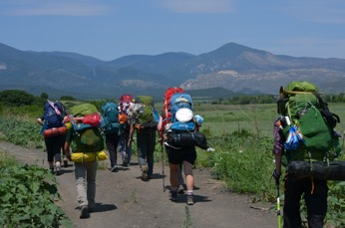
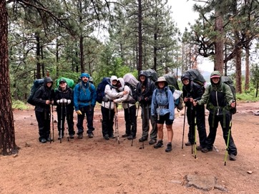
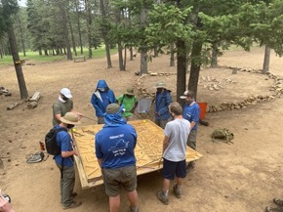
Troop 1345
Outdoor High Adventure Guide
Notes:
Make sure to introduce yourself before you get started! Who are you? What’s your role? Etc.

Slide 2
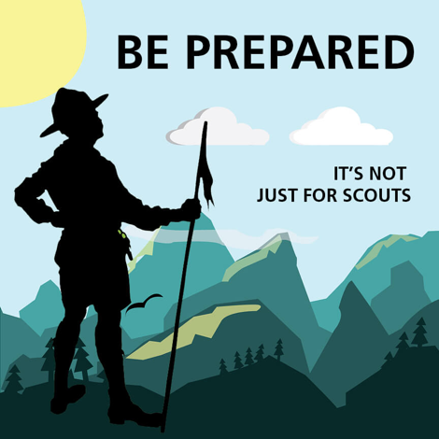
Scouting Mission
“The mission of the Boy Scouts of America is to prepare young people to make ethical and moral choices over their lifetimes by instilling in them the values of the Scout Oath and Law.”

Slide 3
Scouting Aims and Methods
Aims of Scouting:
Character Development
Leadership Development
Citizenship Training
Personal Fitness
Methods of Scouting:
Ideals
Patrols
Outdoor Programs
Advancement
Association with Adults
Personal Growth
Leadership Development
Uniform
Participating in a High Adventure a Scout can put all this to action……

Slide 4
Why an Outdoor and High Adventure
Seek greater challenges for a Scouts physical and mental abilities.
Allows Scouts to “stretch” to attain the goal of successfully completing an exhilarating outdoor experience.
A High Adventure is an experience in living and cooperating with others to meet an exciting challenge. It is learning to overcome difficulties and learning to live in harmony with nature.
Scouts will gain confidence, humility, and self-reliance. Trekkers become self-reliant by acquiring a wealth of knowledge and skills. High adventure develops critical thinking, judgment, and decision-making skills.
High adventure stimulates good citizenship through teamwork and opportunities for leadership. It emphasizes spirituality by bringing Scouts closer to nature. It connects Scouts to the land, developing a bond of respect for wild places and wild things. Through high adventure, a Scout becomes committed to wildland stewardship.
High adventure inspires Scouts to undertake worthy challenges and to work together to meet common team objectives. It offers a meaningful and lasting experience in their lives.

Slide 5

Why a High Adventure
Scouts who wants a challenge (hiking, backpacking, rafting, kayaking, rock climbing, shooting, pioneering, canoeing, orienteering, etc.)
Scouts who enjoys the outdoors.
Scouts who like seeing sites and experiencing activities you can only see by hiking.
Scouts who enjoy a minimalistic camping experience (carry it on your back) or over your head…..

Slide 6

Scout High Adventure Opportunities
Ways to go -
Troop Led
Council Contingent Trips
Individual
Passport to High Adventure –A great planning tool for epic high adventure treks and campouts! https://filestore.scouting.org/filestore/pdf/Passport_to_HighAdventure_34245(16).pdf

Slide 7
How to go on a High Adventure
Research & select a HA Base
• Recruit a crew of Scouts and Adults or for individuals seek council contingent
• Size depends on Adventure selected
• Unit HA Coordinator plans logistics & COST
• Travel (air & ground transportation)
• Lodging and meals
• Enroute tours, sightseeing, acclimation activities

Slide 8
High Adventure Planning
Research and compare locations
• Factor in costs, schedule, crew composition
• Talk to the Troop or HAC!! (decades of experience…)
• Visit - scouting.org/outdooradventures/open4adventure/
• Review the options with your Youth
• Crew decides!

Slide 9
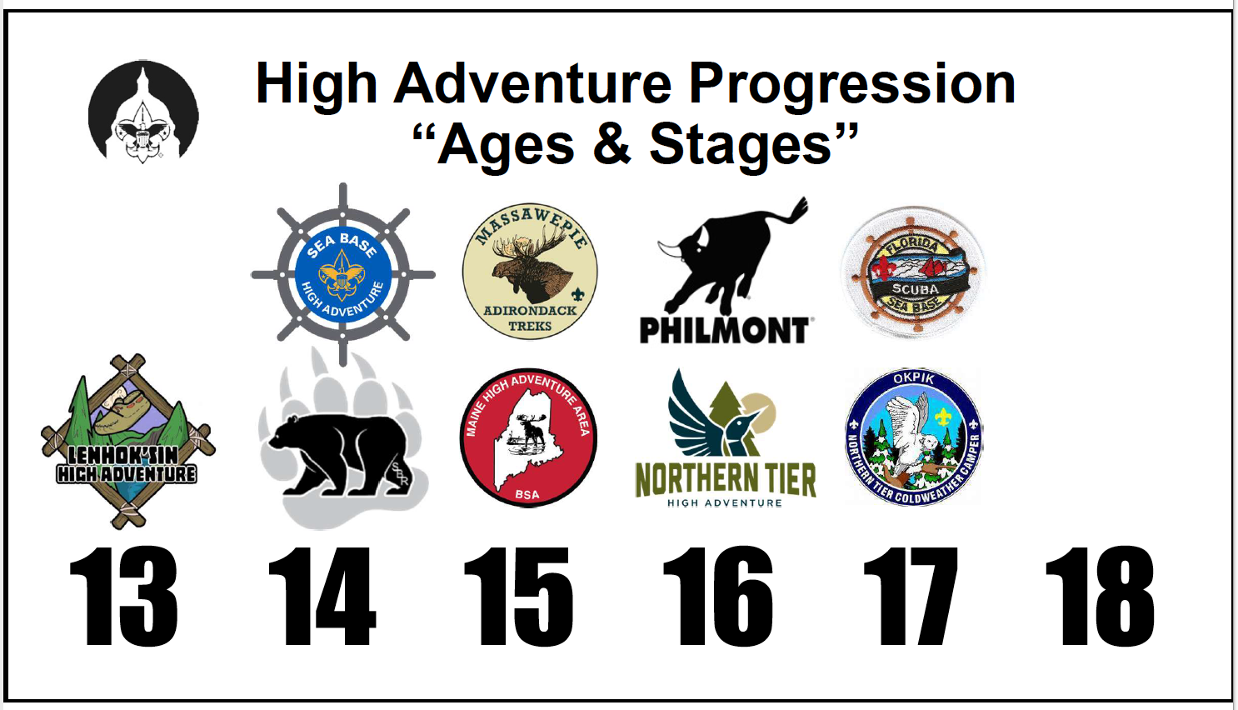
Example of a Troop High Adventure Planning Timeline….

Slide 10
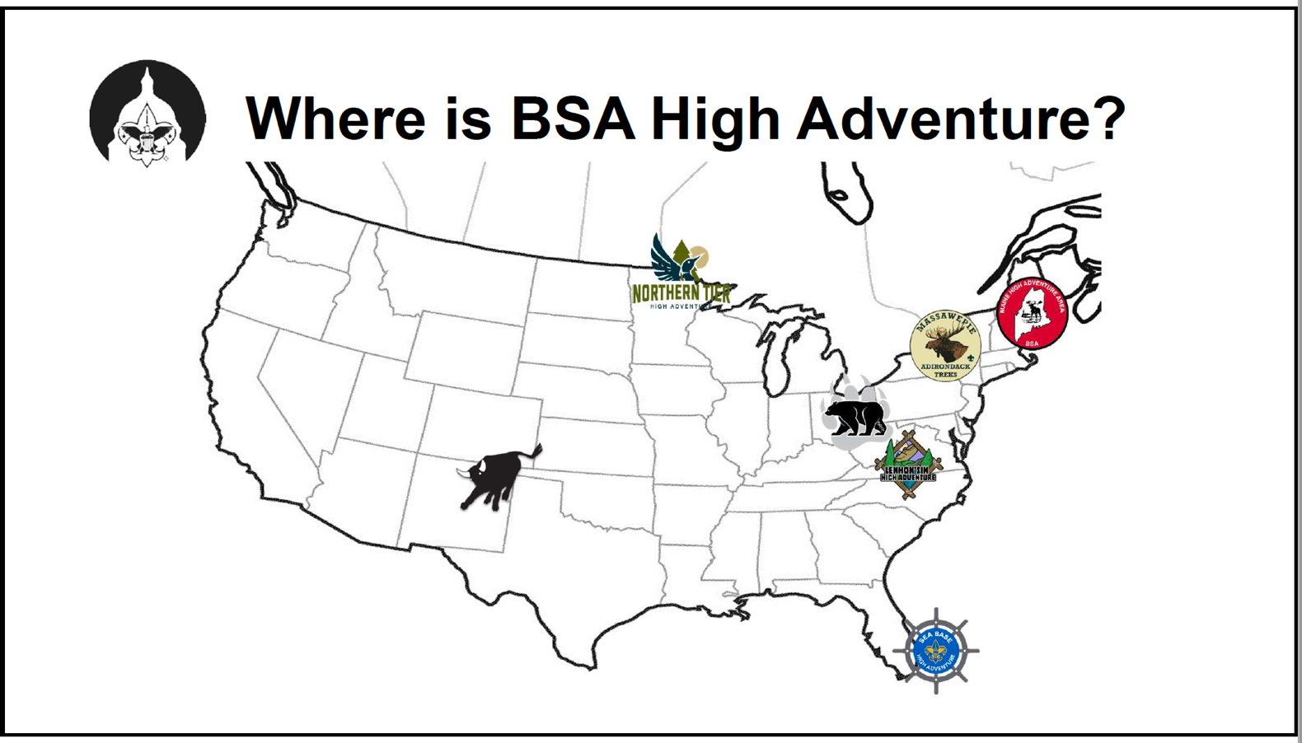

Slide 11
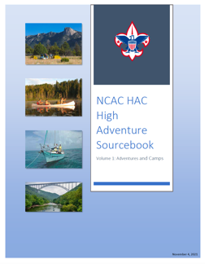
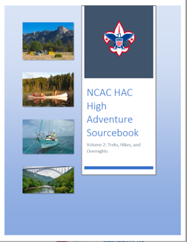
NCAC - Council High Adventure
The National Capital Area Council (NCAC) High Adventure Committee (HAC) is dedicated to promoting high-adventure programs in all NCAC districts by providing information and assistance to NCAC youth and adults on High Adventure program opportunities, and conducting planning, logistics and training for expeditions to National and regional High Adventure bases with contingent crews from our Council.
Volume 1 Sourcebook is comprised of information from numerous Council, District, camp, and other sources to provide current information on the many High Adventure opportunities across the United States and around the world.
  NCAC High adventure source book volume 1 – Adventures and Camps https://public.3.basecamp.com/p/gPPyixZdGr1FLP5M2C8yuAt1
Volume 2 Sourcebook is comprised of many treks and hikes in the Mid-Atlantic region, great for preparing for the many High Adventure opportunities across the United States and around the world.
  NCAC High Adventure source book volume 2 – Treks, Hikes and Overnights https://public.3.basecamp.com/p/UEH3o3JD9c1XtSYRFmr9nFKS
NCAC High Adventure Home Page Website (https://www.ncacbsa.org/high-adventure/)

Slide 12
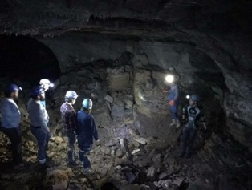

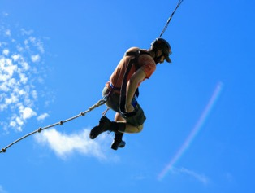

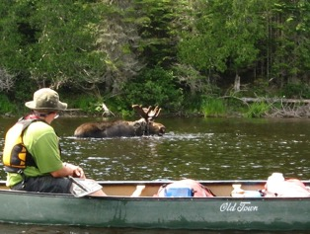
NCAC - Council High Adventure examples….
NCAC Lenhok’s High Adventure @ Goshen Scout Reservation (“Philmont of the East”) http://www.gotogoshen.org
  ATV Program
  Expanded Shooting Sports
Claytor Lake Aquatics Base / Blue Ridge Scout Reservation – Specialty Camp
www.bsa-brmc.org
High Knoll Trail /Blue Ridge Scout Reservation – Trek Camp
www.bsa-brmc.org
Maine High Adventure Base - https://www.mainehighadventure.org/

Slide 13
Council High Adventure Bases
Councils around the country operate smaller High Adventure bases with their own High Adventure programs
  Home Page - https://tap.scouting.org/council-operated-high-adventure-bases/
Colonial Council has CHASE for advanced water sports, COPE, climbing www.cvcboyscouts.org
Yellowstone High Adventure Outpost www.campbuffalobill.com
Adirondack Park — Northern New York
  6,000,000 acres and 46 peaks over 4,000 feet
  Over 3,000 lakes and ponds and over 6,000 miles of rivers and streams
  Hiking, canoeing, climbing
Maine High Adventure
  3,000,000 acres
  100 miles of the Appalachian Trail
  The same waterways that inspired Henry David Thoreau
Chilkoot High Adventure Base
  Inside Passage
  Mountains, rivers, fjords
  International Wilderness Leadership School
Swamp Base www.bsaswampbase.org

Slide 14
BSA National High Adventure Bases
Philmont Scout Ranch in New Mexico (backpacking adventure) www.philmontscoutranch.org;
  videos - https://www.philmontscoutranch.org/resources/promotephilmont/videos/
Northern Tier in Minnesota and Canada (canoe adventure) www.ntier.org;
  videos - https://www.ntier.org/videos
Sea Base in the Florida Keys, Bahamas and USVI (aquatic-based adventure) www.bsaseabase.org;
  videos - https://www.youtube.com/channel/UCr-OuRgyM8QRG36Bv3qL8Ag
Summit Betchel Reserve in West Virginia (river, shooting, climbing, biking…) www.summitbsa.org;
  videos - https://www.youtube.com/c/TheSummitBechtelReserve
Each of the camps have multiple treks
Scouts BSA High Adventure Website - Open4Adventure
(https://www.scouting.org/outdooradventures/open4adventure/

Slide 15
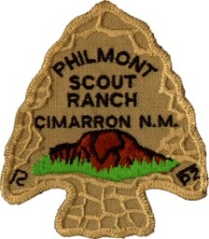
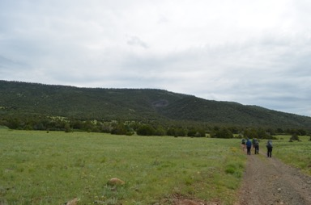
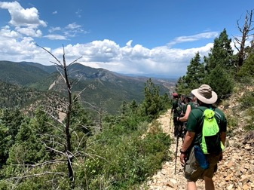
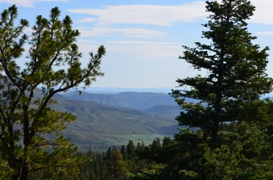
Philmont
BSA’s largest high adventure base
Covers 137,000 acres of mountain wilderness
Located in the Sangre de Cristo range of the Rocky Mountains in New Mexico
34 staffed camps and 55 trail camps
High mountains with rough terrain and elevations that range from 6500 to 12441 feet

Slide 16
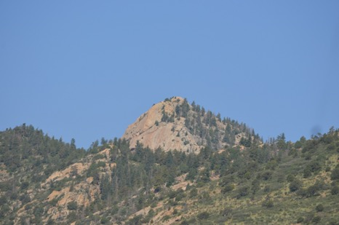
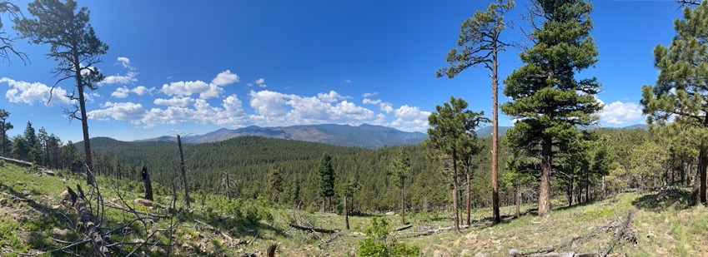
Philmont
Backpacking adventure, with treks from challenging to super strenuous
Features the Old West style activities, such as horseback riding, burro packing, panning, chuck wagon dinners and history
Also features new challenges such as rock climbing, mountain biking, tomahawk throwing, spar pole climbing, ATVs, and rifle shooting

Slide 17
Philmont
Backpacking Treks in Sangre de Cristos mountains
12 day
  Hike 50-120 miles in the backcountry and participate in programs activities & Conservation work
9 day trek
  Hike 50-100 miles in the backcountry and participate in programs activities & Conservation work
7 day trek
  Hike 50-100 miles in the backcountry and participate in programs activities 7 Conservation work
Philmont Backcountry Programs - https://www.philmontscoutranch.org/philmonttreks/facilities/programfeatures/
  examples...archaeology, blacksmithing, burro packing, chase ranch, crew fires, fly-fishing & fishing, geocaching, horse rides, mountain packing, mountain hiking, shooting sports and many more etc…
Indiviual treks – NAYLE, ROCS, Ranch Hands, Trail Crew, Rayado (Horsemanship), STEM,

Slide 18
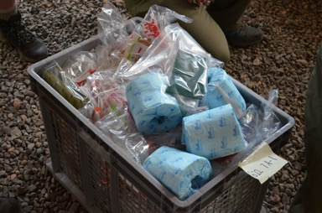
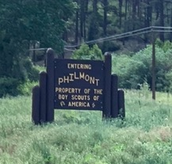
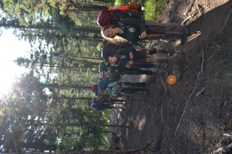
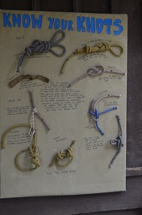
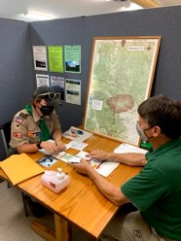
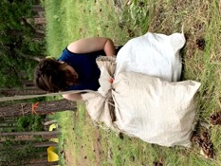
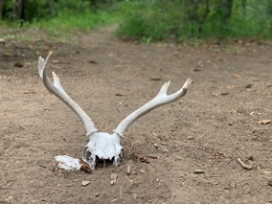
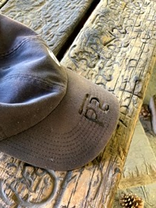
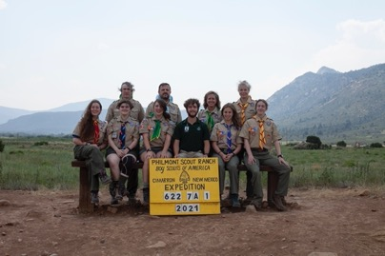
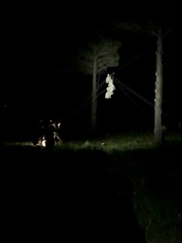
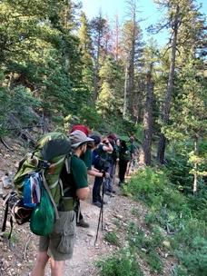
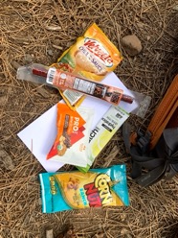
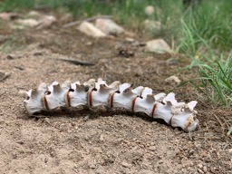
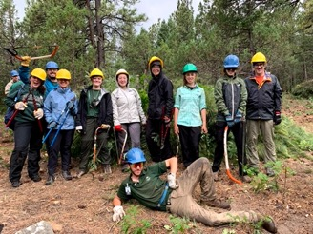
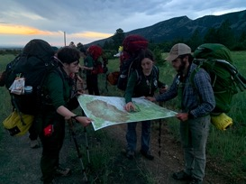
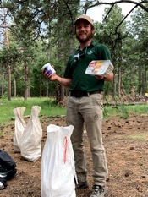
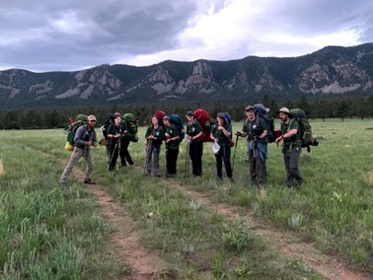
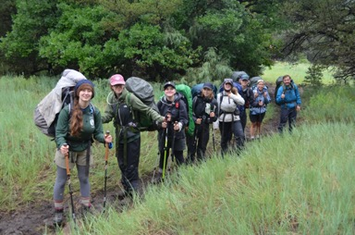
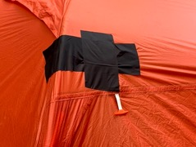
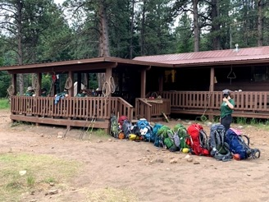
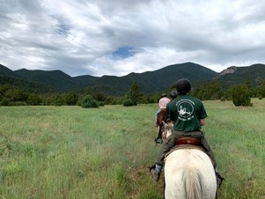
Philmont

Slide 19
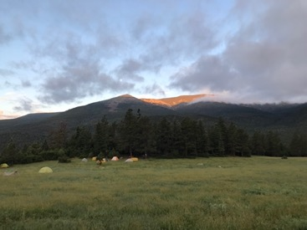
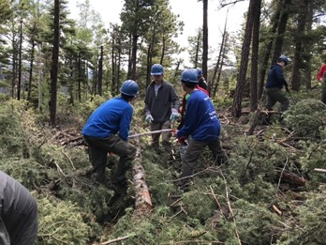
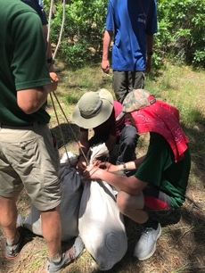
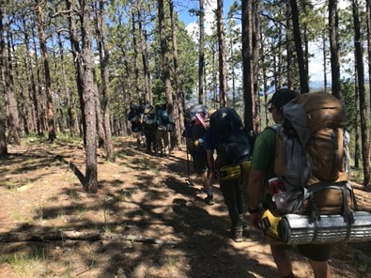
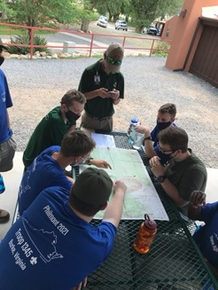
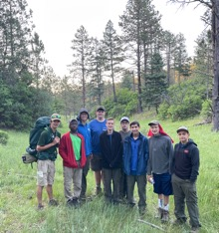
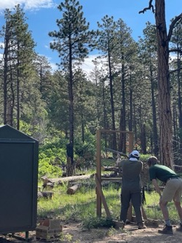
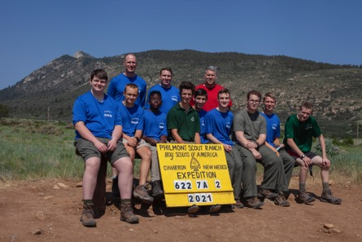
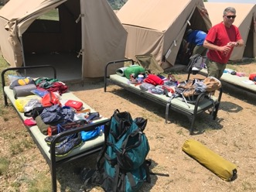
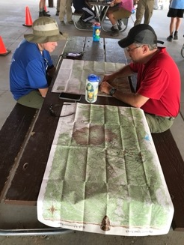
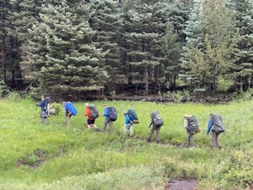
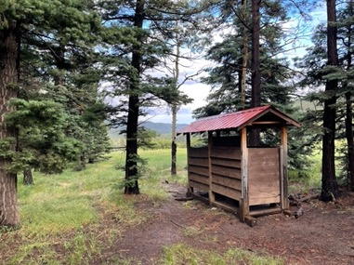






Philmont

Slide 20



Northern Tier
A wilderness canoeing adventure in northern Minnesota,
northwestern Ontario, northeastern Manitoba
A trained staff member accompanies the crew for their trek
Ranges from 6-10 days and covers 50-150 miles of hiking, canoeing and portaging
Charles L. Sommers, MN, Donald Rogert Base, ON, or Northern Expeditions Base

Slide 21


Northern Tier
Charles L. Sommers Canoe Base, MN
Has hosted BSA canoeing expeditions on Moose Lake since 1941
Trips out of Sommers base are limited to the size of 8 plus an interpreter
Allows individual Scouts and smaller troops to take a high adventure trip
CREATED BY CR VENTURING, 2016

Slide 22


Northern Tier
Donald Rogert Canoe Base, ON
Located 80 miles from Sommers base
Expedition spread across Canadian Crown Lands to White Otter Provincial Park
Crew sizes may be up to 11 participants plus and interpreter
Program include a fishing expedition
CREATED BY CR VENTURING, 2016

Slide 23


Northern Tier
Northern Expeditions Canoe Base, MB
Most rugged and remote region paddled by Northern Tier crews
All crews enter the wilderness in a 20 minute float plane, and dropped off into Atikaki Provincial Park
Crews are limited to the size of 11 plus an interpreter
Fishing in region is world class: northern pike and catfish
Bissett is most appropriate for older crews with previous experience with high adventure
CREATED BY CR VENTURING, 2016

Slide 24

Okpik
Sessions in December over winter break
Sessions in January and over President’s Holiday
Sampler program
  Ski, snowshoe, dogs (weather permitting)
  Musher treks extremely hard to get
  Cabin Stay – for 12 yr olds + and does not qualify for high adventure triple crown or grand slam awards - Not recommended
Next Okpik sign-up is November:
  December or January Okpik Winter Treks
  Watch the NT web site

Slide 25


















Northern Tier

Slide 26



















Northern Tier – Okpik Winter

Slide 27



Seabase
Located in Bahamas and Florida
There are many types of water adventures to choose from
Each has a different type of experience and skill sets
When choosing with your crew, make sure to read each adventure and see which one seems more fun and interesting to you

Slide 28


Seabase
Bahamas Tall Ship Adventure
Fly directly to the Bahamas
Sail throughout the Bahamas aboard a tall ship, 60’ catamaran
18-20 people
Active ship and require everyone to work as a team and experience the workings of sailing
7 day event
Bahamas Adventure
Based in the Marsh Harbour on Great Abaco Island
You will board a traditional Bahama sailing vessel
Snorkeling, fishing, and swimming
7 day event
10-12 people
CREATED BY CR VENTURING, 2016

Slide 29


Seabase
Out Island Adventure
Big Munson. The out island adventure combined with camping on a 100+ acre island
Snorkeling on coral reefs, trolling for sport fish, kayaking and exploring the island
7 day event
10-14 people
Sea Exploring (Keys Tall Ship)
Tall ship sailing on a 75ft boat, with a gaff-rigged schooner
Snorkeling, swimming and hands-on sailing in the Florida Keys
8 day event
20 people plus boat staff
CREATED BY CR VENTURING, 2016

Slide 30

Seabase
Coral Reef Sailing
40-50 ft. sailing yacht
Captain will teach you about Navigation and sailing
Fishing, swimming and snorkeling
You get to make your own float plan and explore the beautiful keys
“Port day” at Sea Base with fun activities
7 day, and 14-17 people
Eco-Adventure
Up-close and hands–on educational adventure
2 40’-45’ sailboats
Snorkeling, mask and fins, kayaking, fishing and glass-bottom viewing
You will discover and explore four major marine habitats
7 days, and 10-12 people
CREATED BY CR VENTURING, 2016

Slide 31


Seabase
Florida Fishing
Fishing in several different ecosystems so you can catch all different types of fish
Spanning from the Gulf of Mexico to Florida straights of the Atlantic ocean
7 day
10-12 people
Scuba Adventure
Scuba diving in the coral reefs and wrecks of the Florida Keys
Designed for certified drivers. Eleven dives scheduled
You must be a certified diver
8 days
CREATED BY CR VENTURING, 2016

Slide 32















Seabase

Slide 33







Seabase

Slide 34




Summit
Located in southern West Virginia, covering 10,600 acres of rugged forest
Announced as a National High Adventure Base on November 18, 2009
Home to the National Scout Jamboree
A High Adventure Base, National Center for Scouting Excellence, and a Scouting Summer Camp

Slide 35


Summit
Skateboarding Park: skating
The Trax: BMX
The Pools: scuba and swimming
The Cloud: popular science and robotics
The Bows: archery sports
The Barrels: shooting sports
The Ropes: challenging courses in trees
The Rocks: climbing walls
The Canopy: canopy tours
The Zip: zip lining
Low & High Gear: mountain biking, connecting over 30 miles of downhill and cross country mountain bike trails

Slide 36











Summit

Slide 37


Triple Crown & Grand Slam Award
If you complete all 3 high adventure bases, Philmont, Northern Tier and Sea Base you can receive the Triple Crown Award
If you complete all 4 high adventure bases, Philmont, Northern Tier, Sea Base and Summit, you can receive the Grand Slam Award
Earned once in a lifetime
Only certain treks qualify for the awards -
https://www.nationalhighadventureawards.org/requirements
CREATED BY CR VENTURING, 2016

